Slide 1

Using the ABP FRAMEWORK as an Opinionated .NET Application Architecture
Halil İbrahim Kalkan

Slide 2

Agenda
What is the ABP Framework?
Why use the ABP Framework?
Live coding demo
ABP Framework: feature highlights
ABP Studio demo
The ABP Platform
QA

Slide 3
What is the ABP Framework?

Slide 4
What is the ABP Framework?
ABP Framework offers an opinionated architecture to build enterprise software solutions with best practices on top of the .NET and the ASP.NET Core platforms.
It provides the fundamental infrastructure, production-ready startup templates, modules, UI themes, tooling, guides and documentation to implement that architecture properly and automate the details and repetitive works as much as possible.

Slide 5



ABP: Filling the gap!
Your Application
Focus on your own business code!
ABP Platform
Architecture & Infrastructure for Real-World Business Applications
.NET Platform / ASP.NET Core
Web Application & HTTP Service Development Framework

Slide 6
ABP: The Architecture
Domain Driven Design
& Layered Solution
Modular
Multi-Tenancy (SaaS infrastructure)
Microservice ready

Slide 7
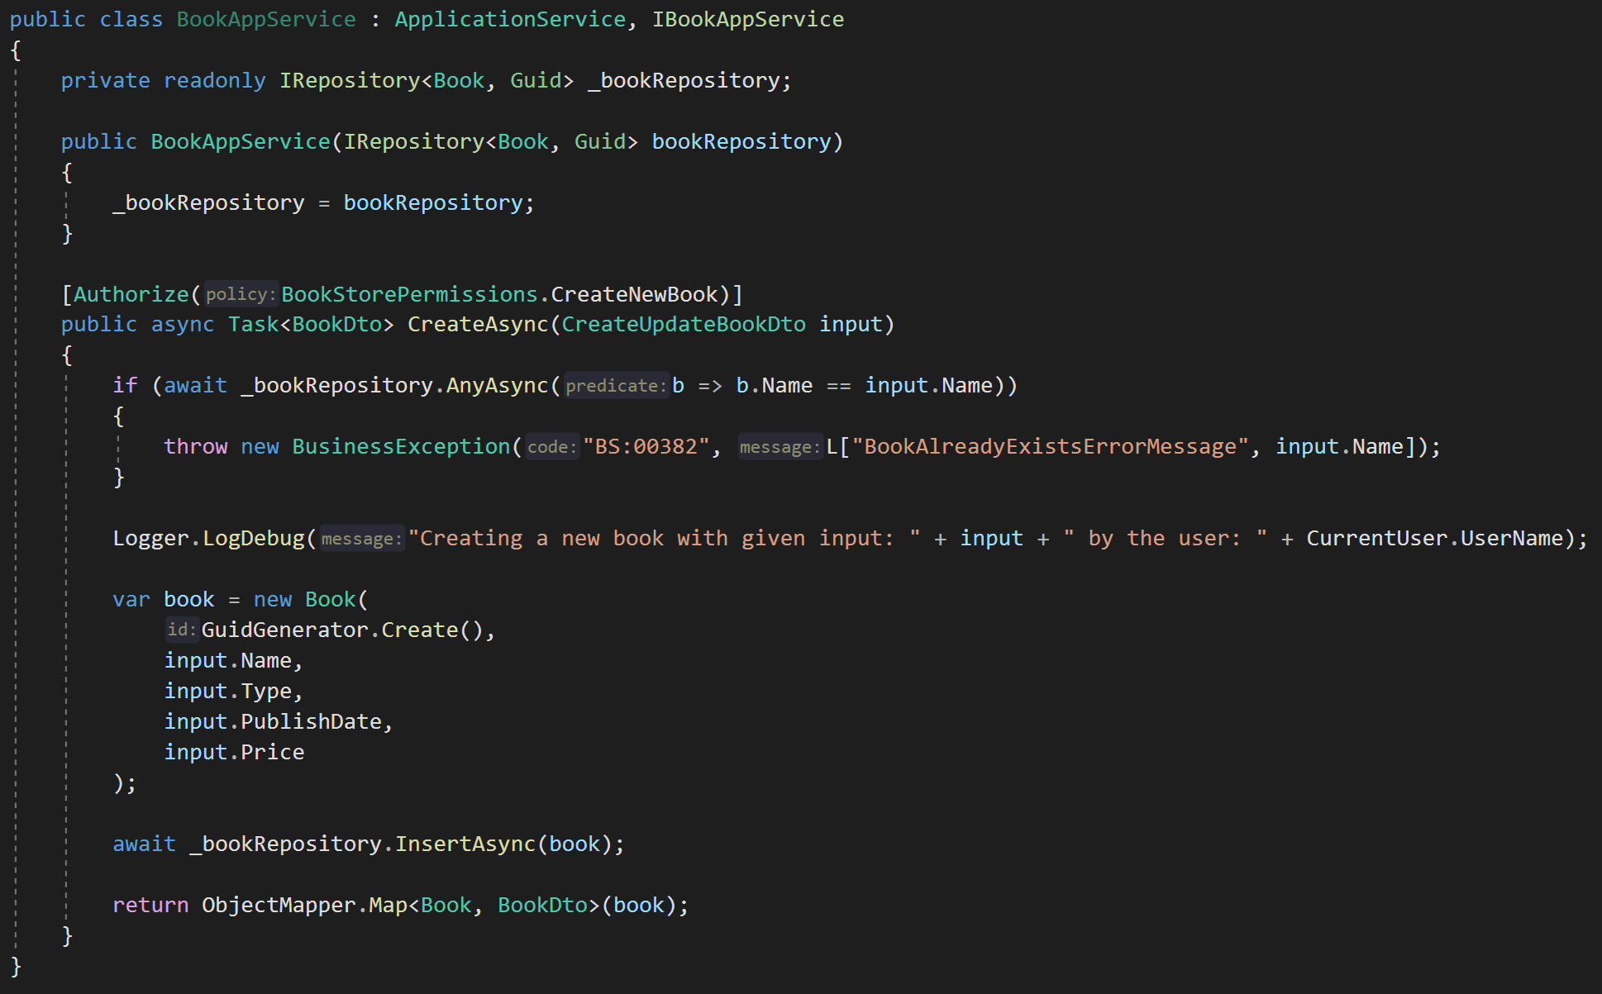
ABP: Infrastructure / Don’t Repeat Yourself!
DDD Base Classes
DI Auto-Register
Generic Repositories
Authorization / Permissions
Auto Validation
Unit Of Work (Transaction Management)
Auto Audit Logging
Localization
Exception Management & Handling
ICurrentUser
ISettingProvider
IFeatureChecker
IGuidGenerator …
Object2Object Map

Slide 8
Why use the ABP Framework?

Slide 9
Why ABP? Challenges of creating a new solution
Creating an empty solution (organizing codebase, layers, 3-rd party integrations, automated tests)
Choosing the common libraries
UI Theme & Layout
Setup the test infrastructure
Coding standards & training the team
Keeping your solution up to date

Slide 10
Why ABP? Don’t repeat yourself!
Authentication
Cross-cutting concerns
Architectural infrastructure
Enterprise application requirements
Tooling to automate the repeatitive work
Integrating & abstracting 3-rd party libraries

Slide 11
Why ABP? Architectural infrastructure
Modularity
Saas / Multi-tenancy
Microservices
Having pre-built & reusable modules

Slide 12
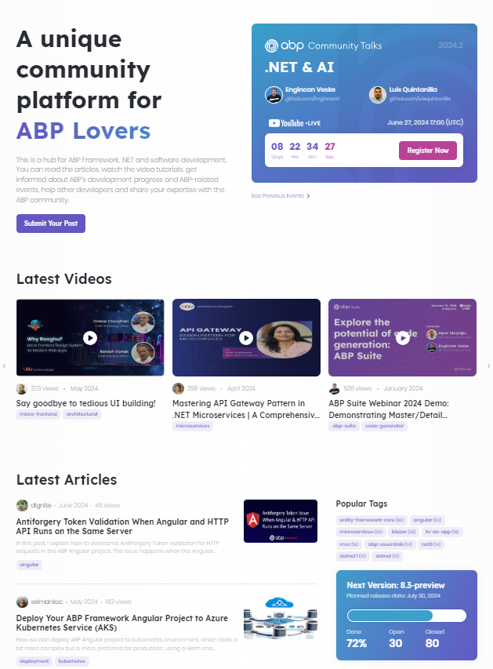
Why ABP? The ABP Community
GitHub
8 years of active development
200+ releases
350+ contributors
9,000+ issues closed
10,000+ PRs merged
36,000+ commits
ABP Community
200+ articles
100+ video tutorials
Live events, Conferences, Raffles, Discord,...

Slide 13
Demo: Live Coding

Slide 14
ABP: Other features
Distributed event bus (RabbitMQ, Kafka, Rebus, Azure... integrations)
Automatic / simplified dependency injection
Background workers and background job queues
Automatic data filtering (e.g. Entity.IsActive)
Automatic audit logging / entity histories
Distributed locking
Image manipulation
Email / SMS sending
...

Slide 15
Demo: ABP Studio

Slide 16



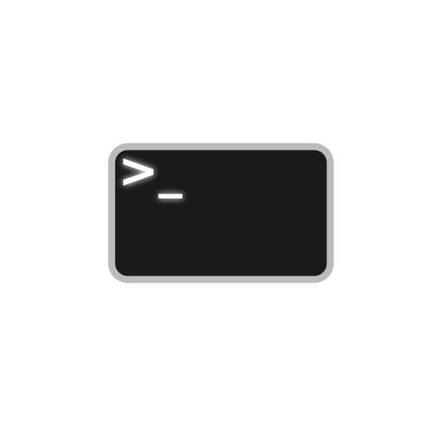















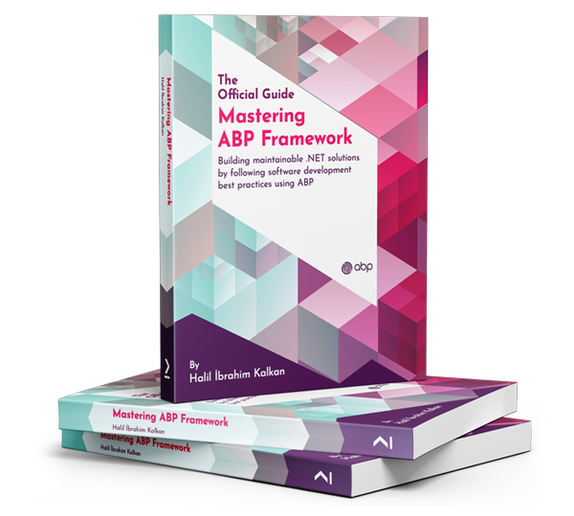



The ABP Platform
Startup Templates
More Startup Templates
Framework Packages
CLI
Pro Themes
Basic Themes
Pro Modules
Framework
Commercial
Basic Modules
Examples
Docs & Books
Community
Events
eShopOnAbp
Discord
Articles
Video Tutorials
Blog

Slide 17
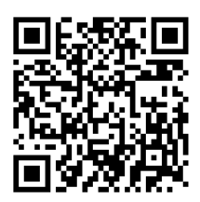


Thanks! Questions..?
Twitter: hibrahimkalkan
Halil İbrahim Kalkan
Co-founder of
Web: https://halilibrahimkalkan.com GitHub: hikalkan
Twitter: hibrahimkalkan
ABP Framework: https://abp.io
This Presentation: https://github.com/hikalkan/presentations

Slide 18

Topic title
Content

